Slide 1
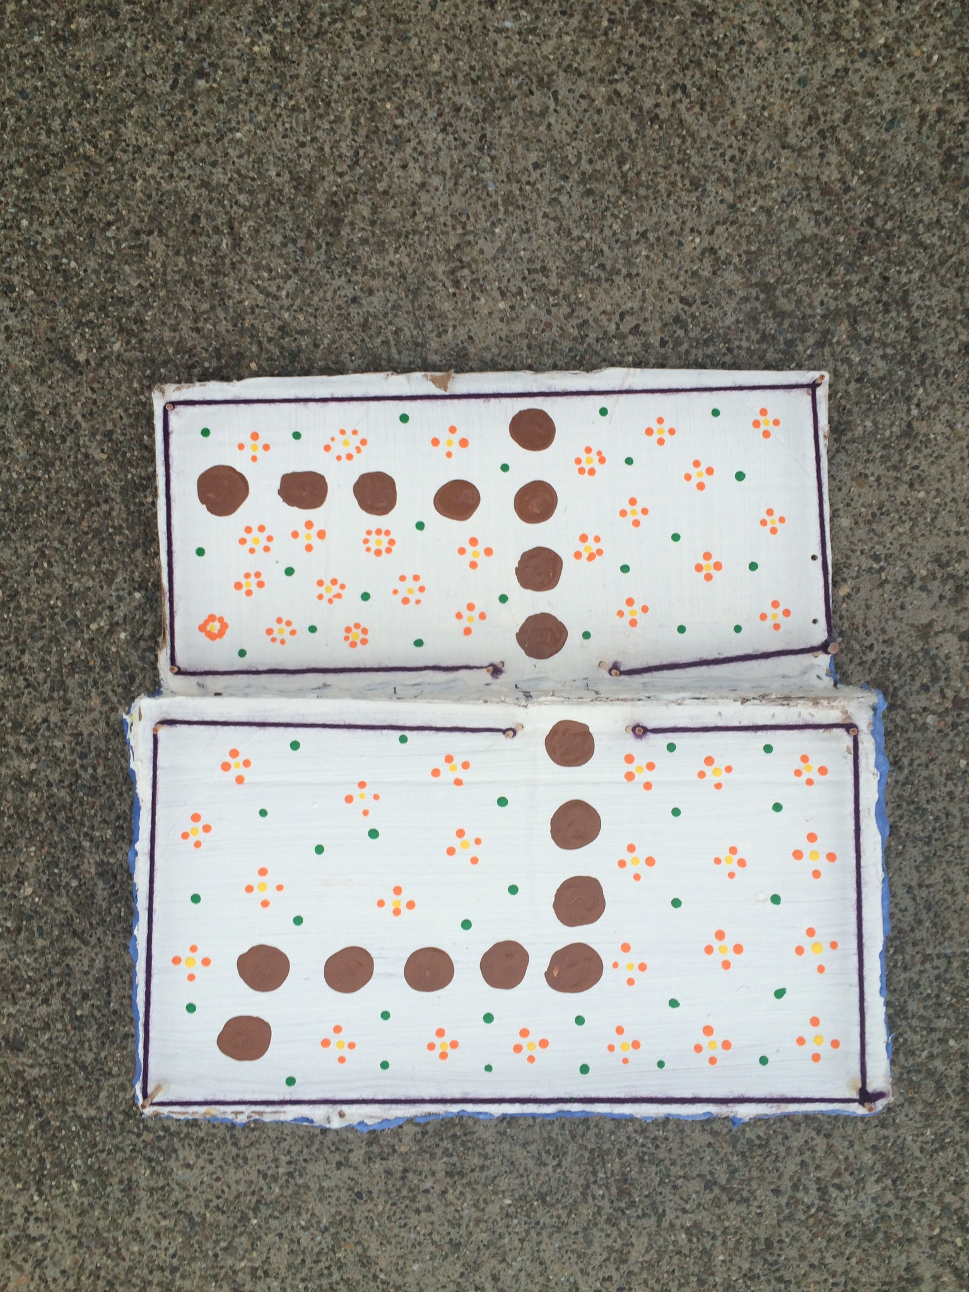
Bonus plan
Living Solar Studio Roof

Slide 2
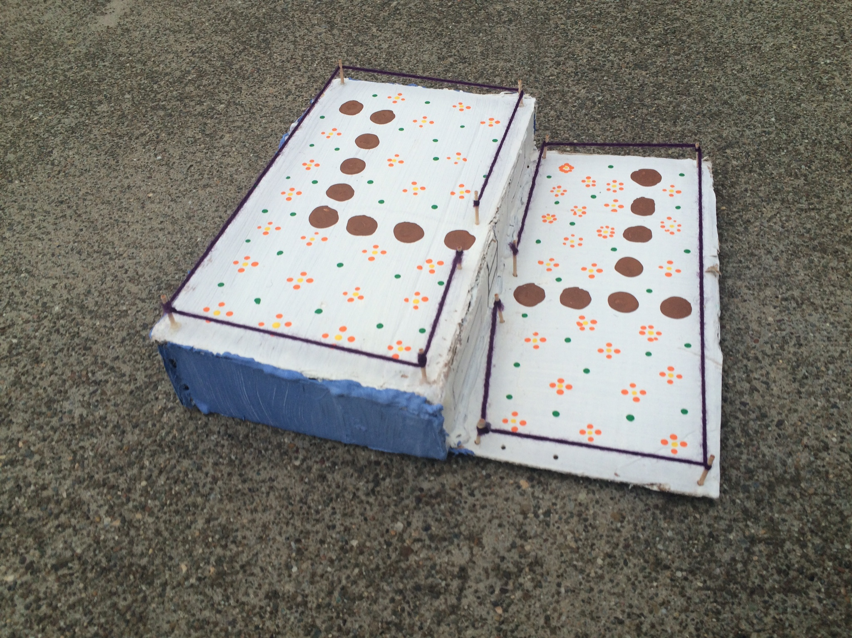
This is a model of just the roof

Slide 3
Materials list
Pond liner
Root membrane
Gravel
Moisture blanket
Wood chips
Compost
Top soil
Hardy drought resistant plants
Fencing
Ladders
Irrigation system

Slide 4
Budget
Pond liner = $68
Root membrane = $30
Gravel = $ 24
Moisture blanket = $50
Wood chips = $75
Compost = $40
Top soil = $55
Hardy drought resistant plants = $100
Fencing = $115
Ladders = $315
Irrigation system = $100
Approx. $1,000

Slide 5
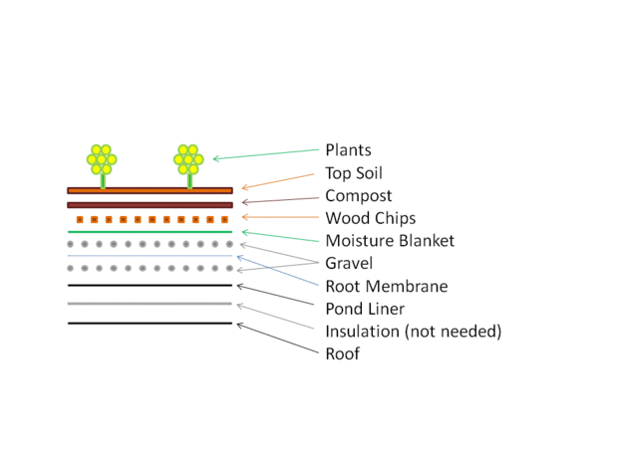
Building steps
Also install the ladders, fencing, and irrigation system

Slide 6
Benefits
Provides great insulation
Help stormwater management
Aesthetically pleasing
Improve air quality

Slide 7
Possible Issues
The biggest issue we face is running water from the school to the irrigation system
Since we didn't have the opportunity to go up onto the roof the measurements are just rough estimates. Also we have to worry about the total weight the roof can hold so we would have to consult a contractor to help figure that out.

Slide 8
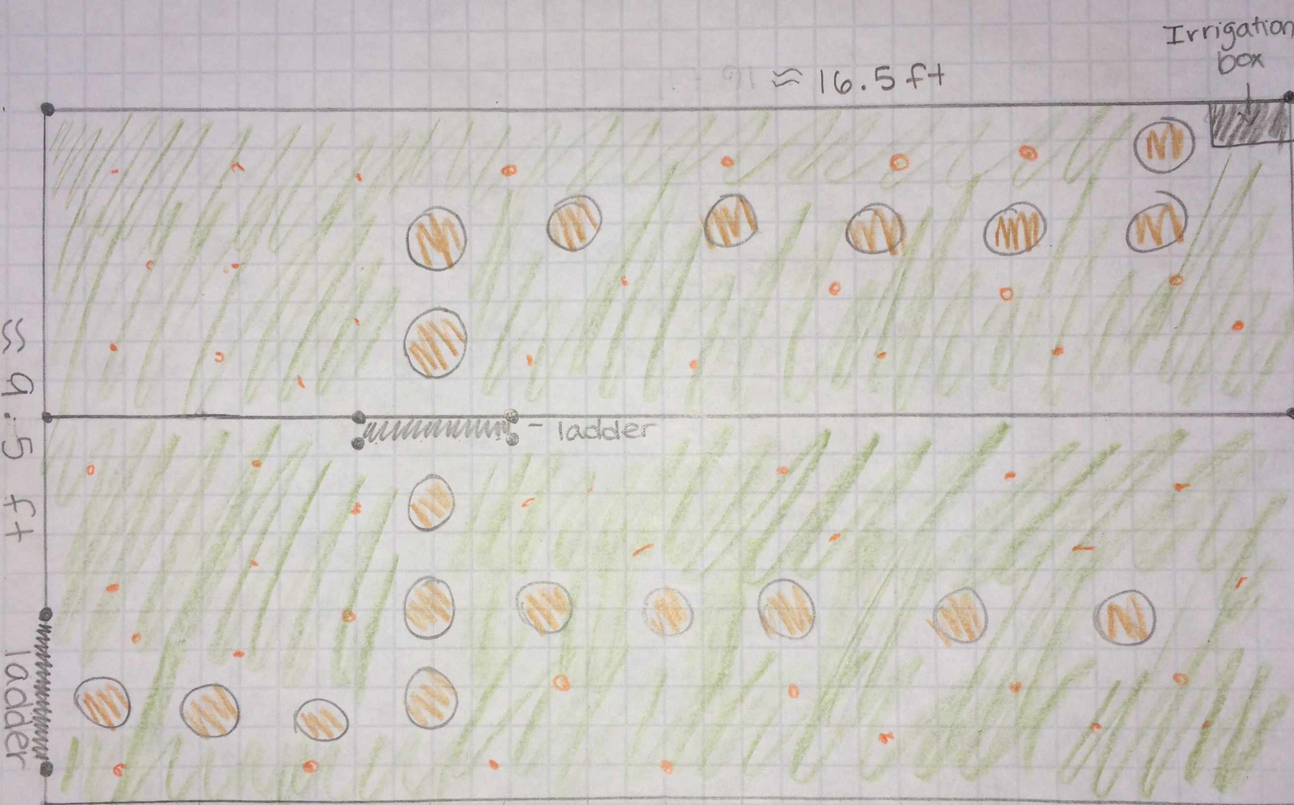
Scale model

