Slide 1
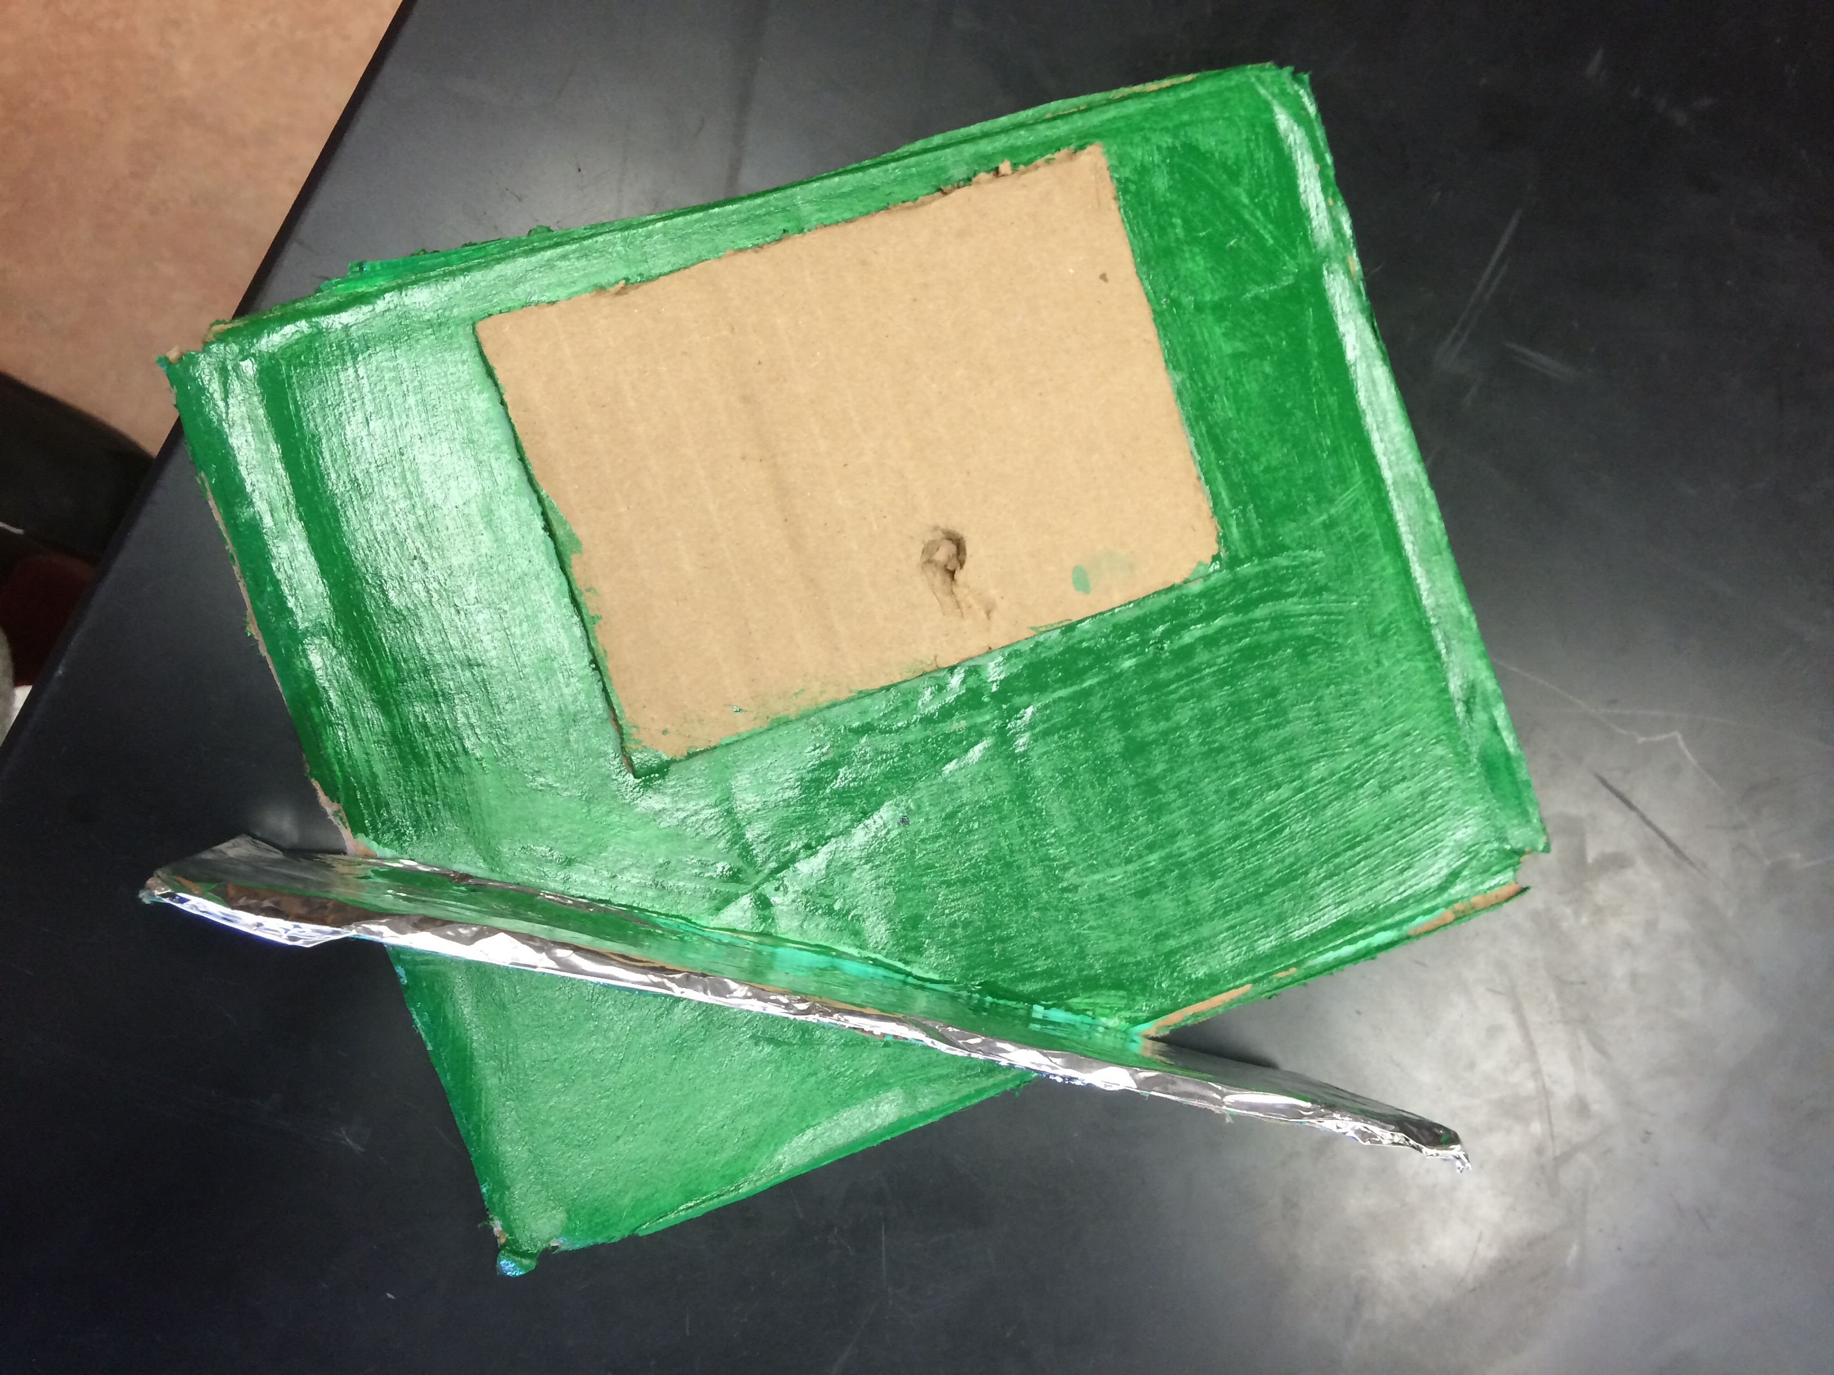
North Window
By: Matt, Ruby, Madi

Slide 2
Materials List
Cardboard: Wood
Aluminum foil: Mirror
Total cost-approximately $80

Slide 3
Purpose
This solar reflector will be used to get more light into our mini solar home

Slide 4
How it works
The sunlight hits the reflector which is located under the window, but due to the upward 52 degree of the reflector the sunlight reflects back up into the window

Slide 5
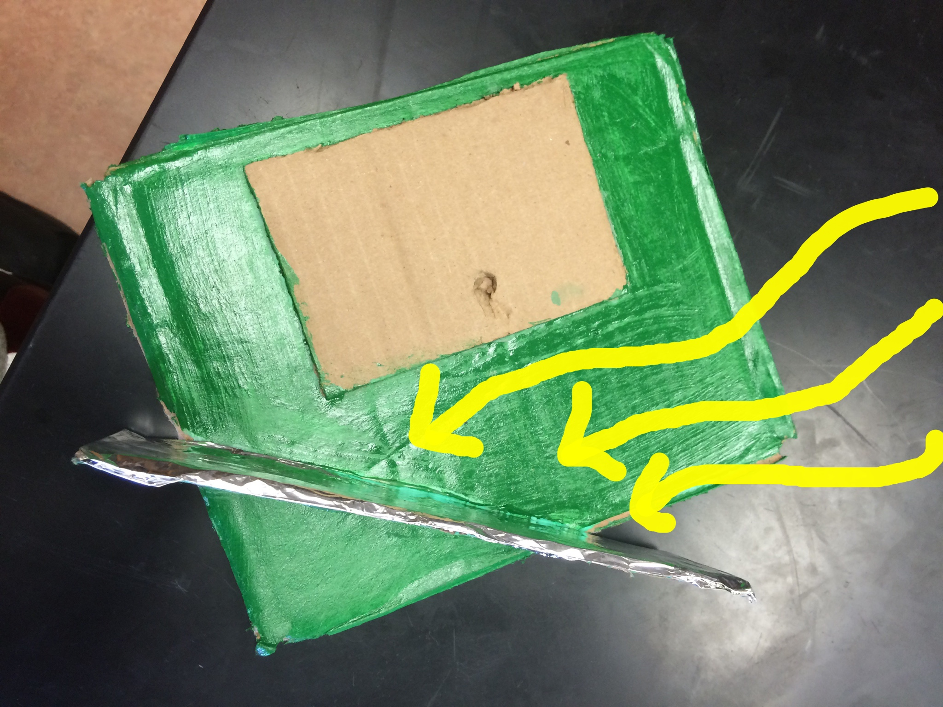
Light hitting reflector

Slide 6
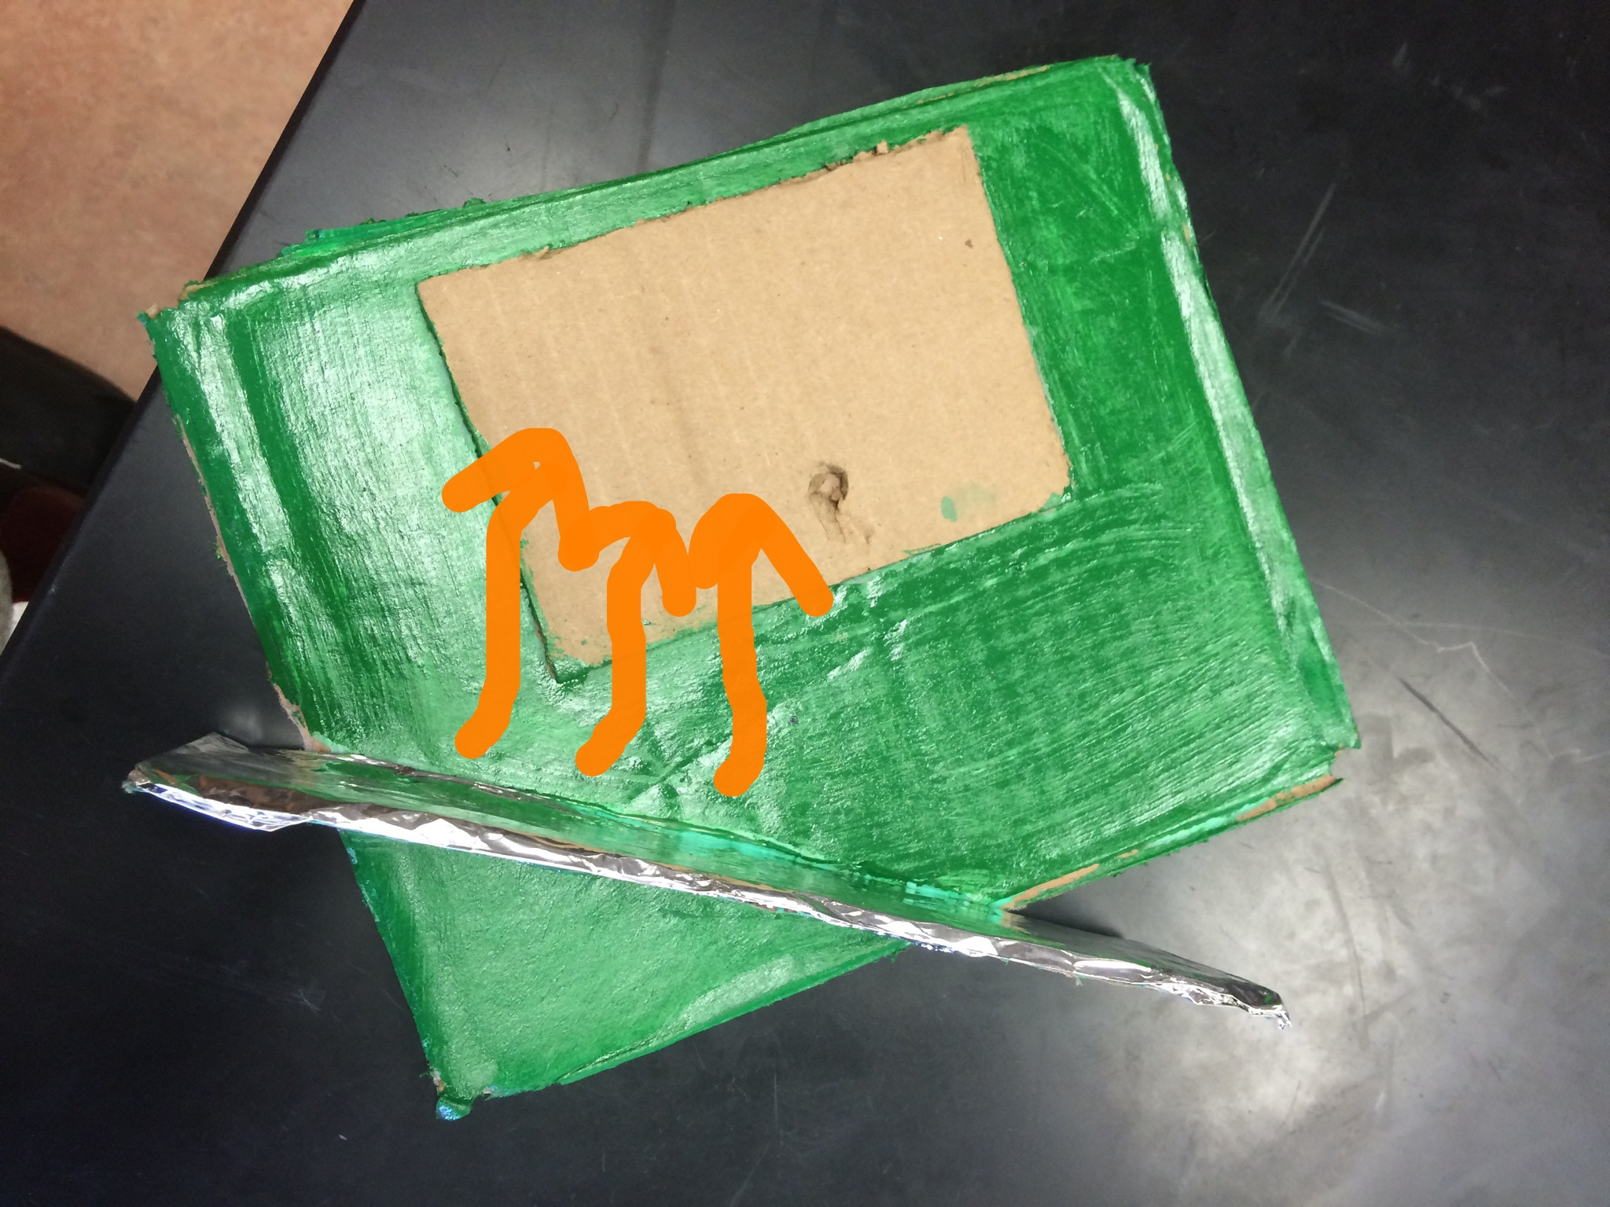
Light reflecting off the reflector

Slide 7
What are benefits of a solar reflector?
A solar reflector would be a great addition to our solar house here at San Marin. This will bring more natural lighting into the house. The project of installing the reflector would not take long and it would be very affrdable to install and maintain

